Slide 1
NIST CSF

Slide 2
【資安框架】NIST CSF 1.1：英美各國政府和一般企業都相繼採用的網路安全框架
面臨嚴峻的資安情勢，無論企業的規模，都要落實相關的防護工作，
但要如何著手，將有限的資源充分運用在需要優先加強的部分，
而非想到什麼就去做，這是NIST制訂網路安全框架中，所表達的重要精神
文/周峻佑 | 2019-04-21發表
https://www.ithome.com.tw/article/129614
NIST Cybersecurity Framework概覽
報告人 : 萬幼筠
https://s.itho.me/events/2019/cybersec101/0906_0910.pdf

Slide 3

The Cybersecurity Framework Three Primary Components
Core框架核心
Desired cybersecurity outcomes organized in a hierarchy and aligned to more detailed guidance and controls
Profiles框架設定檔
Alignment of an organization’s requirements and objectives, risk appetite and resources using the desired outcomes of the Framework Core
Implementation Tiers實施層級
A qualitative measure of organizational cybersecurity risk management practices

Slide 5
The Framework Core

Slide 7
The Framework Core Establishes a Common Language
Describes desired outcomes
Understandable by everyone
Applies to any type of risk management
Defines the entire breadth of cybersecurity
Spans both prevention and reaction
Function
Identify
Protect
Detect
Respond
Recover

Slide 8
Function
Identify(6)
Protect
Detect
Respond
Recover
ID.AM | Asset Management (ID.AM):
ID.BE | Business Environment (ID.BE):
ID.GV | Governance (ID.GV):
ID.RA | Risk Assessment (ID.RA):
ID.RM | Risk Management Strategy (ID.RM):
ID.SC | Supply Chain Risk Management (ID.SC):
共6子主題

Slide 9
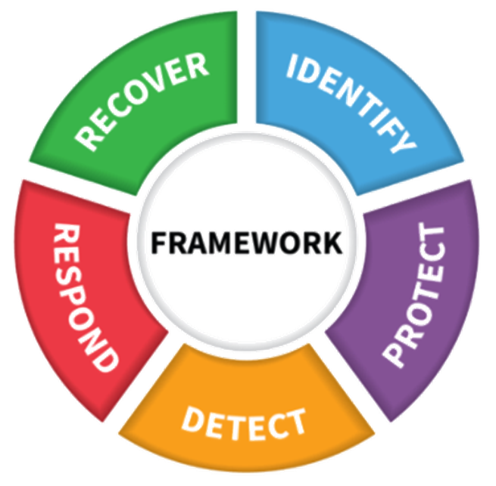
CSF五大功能
資安事件前的「識別」（Identify）與「保護」（Protect）
資安事件中的「檢測」（Detect）
資安事件後的「回應」（Respond）與「復原」（Recover）

Slide 10
Profiles

Slide 11
Implementation Tiers

Slide 12
Implementation Tiers The Cybersecurity Framework Version 1.1
 | 1 | 2 | 3 | 4
 | Partial | Risk Informed | Repeatable | Adaptive
Risk Management Process | The functionality and repeatability of cybersecurity risk management
Integrated Risk Management Program | The extent to which cybersecurity is considered in broader risk management decisions
External Participation | The degree to which the organization: monitors and manages supply chain risk^{1.1} benefits my sharing or receiving information from outside parties

Slide 13
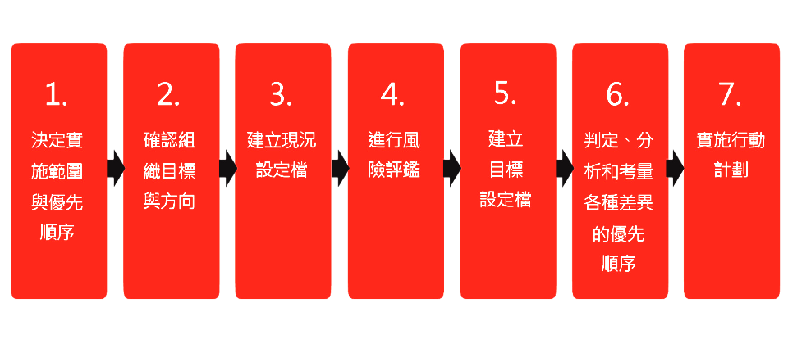
使用NIST網路安全框架的7大步驟
scope
在2018年的NIST CSF 1.1版後，不僅是將5大功能，從22類別與98項子類別，擴增到23類與108項。在此當中，新版特別針對供應鏈安全、身份識別與驗證，以及自我評估資安風險的內容，進行強化，因此，更能貼近目前實務面的需求，並成為不限組織規模大小和業務型態，所有企業對於網路安全強化都能通用的架構。

Slide 14
Cybersecurity Framework Version 1.1

